Slide 1
Presentation Storyboard
Introduction and Background – Matt – 3 min
Aim: audience knows what we were asked to make, why and for who
Software Architecture – Max - 2 min
Aim: audience understands broadly how the product works and what is happening at each stage in the pipeline
NLP Models – Charlize, Maksym – 5 min
Aim: audience understands how we tackled the NLP challenge of our software
Data and AWS – Louis, Mario – 5 min
Aim: audience understands the how we obtained/processed our data and the challenges involved with doing this at scale
Insights and conclusion – Max + ?? – 5 min
Aim: audience can see for themselves how our product is valuable

Slide 2
For each module:
Start recording with section header in view and introduce what you’re going to talk about
Keep explanations simple
Focus on functionality over code
Script around a demonstration
Pass over to the next person speaking at end of recording
Make sure slides have presentation title and date at the bottom
Advice from Rob
focus on the important elements (not, e.g., how to log in);
provide helpful narration;
grab the audience's attention in the first 60 seconds (state a startling fact / quotation / question / anecdote);
focus on the main accomplishments: technical achievements, your evaluation, how well you met your specification;
include a brief conclusion;
creativity is encouraged (one group last year presented a portion of theirs as a parodic infomercial...this went down very well and was very entertaining).

Slide 3
Recording specs
should be in 16:9 landscape mode;
minimum resolution of 480px;
a mixture of presentation slides and a demonstration of the software you've written;
it can be recorded as a screen-capture or film through a phone or webcam, or a mixture.
Deadline for recordings: MIDNIGHT TODAY

Slide 4
Tracking Brand Sentiment via Public News
Charlize, Louis, Maksym, Mario, Matthew, Max
Supervisor: Professor Alessandra Russo

Slide 5
Agenda
Background
Software Architecture
Data Extraction
ML Pipeline
Cloud Deployment
Visualisation

Slide 6


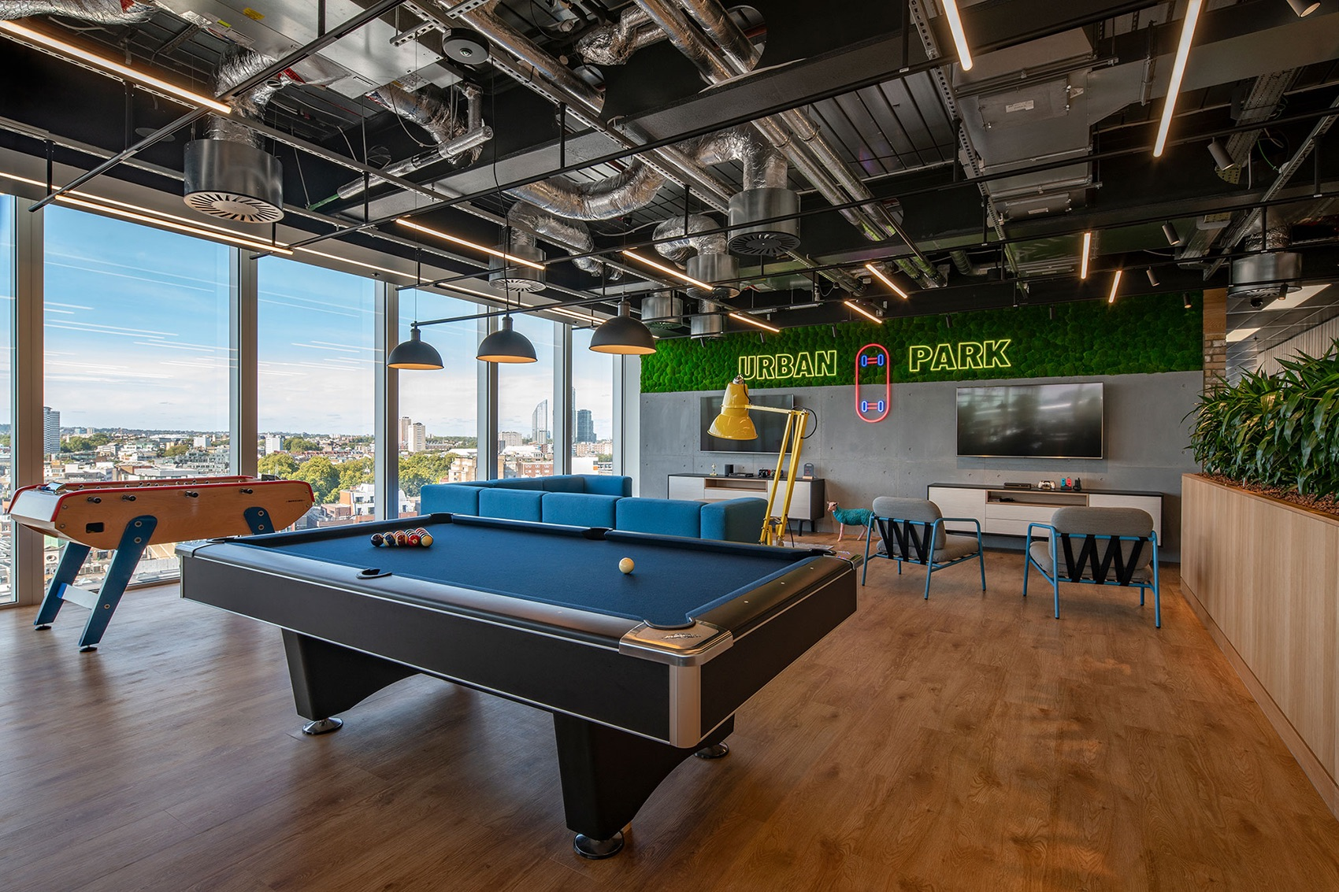
(TTD)

Slide 7
Project Goals
How to extract news article content from a web-page?
How to identify articles mentioning a given brand?
How to detect sentiment in each article?
How to do all of these at scale?

Slide 8
2. Software Architecture
Notes:
Hopefully in 2 minutes time you will have a reasonable understanding about what our software looks like and what it does at a high-level

Slide 9
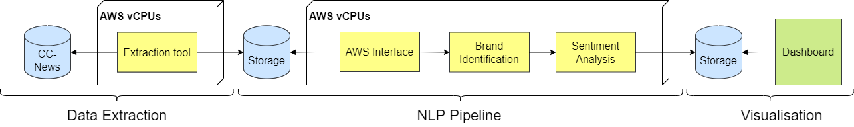
Software Architecture
Notes:
Product is split into three stages: data extraction, NLP modelling and visualisation.
Data flows from left to right
We begin with the Common Crawl News archive. Common Crawl News is essentially a huge open-source data lake containing billions of articles from the internet. However at this point the actual article content is not very readable since the files stored in this archive contain the raw HTML which describes all of the visible content on a web page.
[Demonstrate]
For this reason, created an extraction tool that will make a request to CC-News for a certain number of articles and process the HTML from these articles so that it’s prepared for our Machine Learning Pipeline
Once an article has been extracted and processed it is pushed to an intermediate storage bucket before being picked up by our AWS interface module which essentially acts as a filter and allows us to control which articles we model on.
After this, we have two NLP modules which run in sequence. The first is the brand identification module where we parse the article text and pick out all the ‘entities’ or proper nouns in it. This is a commonly called a Named Entity Recognition (NER) task.
The second is the sentiment analysis module where we classify the article text into ‘positive’, ‘negative’ and ‘neutral’ categories,
Once we have the entities (which includes brands) contained in an article and the general sentiment of it, we append these data to the rest we extracted and push this to a final database which is where the intrinsic value of the MVP is stored.
However, this database alone isn’t an MVP, so to finish the project we connected this database to a business insights dashboard which allows us to visualise and analyse the data that’s been collected. With this dashboard, The Trade Desk can demonstrate the software to potential clients, gather feedback and iterate on it as they see fit.
So that’s a high level overview of our software architecture.
In order for the database to be useful for the The Trade Desk and their clients, it needs to be two things: 1) very big and 2) updated regularly.
This is why we our software pipeline on the cloud, meaning we use Amazon Web Services (or AWS) to run our packages at scale and automate the process so a fresh batch of articles pass through the pipeline every day.

Slide 10
Software Architecture
5
3
4
6
Notes:
Now we’ve seen what happens at each stage of the pipeline, it’s time to get into the details.
We’ll talk first about the data extraction and machine learning pipeline packages, and then a give an overview of the AWS infrastructure we use run our software. To finish, we’ll give you a world premiere of our software in action, so keep it locked.
For now, I’ll pass over to Louis to talk about the data extraction tool.

Slide 11
3. Data Extraction
Notes:
The first stage of our product is the data extraction:
We need articles to work out who the news is talking about daily, and what they think of them.
But how do we do this?

Slide 12
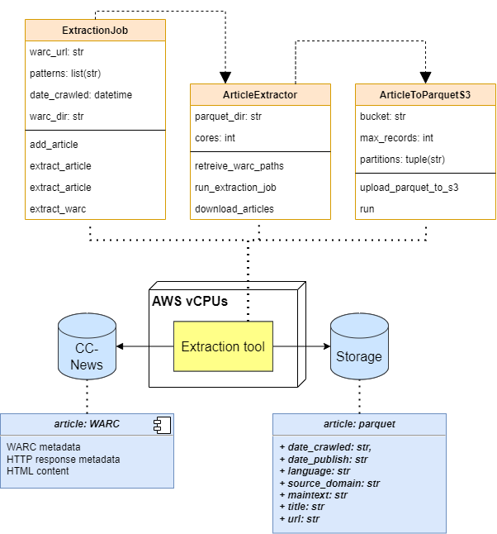
Article Extractor
Data source: Common Crawl (CC-NEWS)
HTML Extractor: newspaper3k
Language Detector: langdetect
Sped extraction up using multiprocessing
Notes:
Our data source for this project is an archive hosted on AWS called Common Crawl.
Common Crawl is a non-profit organisation that crawls the internet for all kinds of web pages and data. Common crawl’s archive holds petabytes of records, which they update on a daily basis and make available for anyone to use.
However, we don’t want everything, especially when dealing with petabytes of data – really, we just want the news articles.
Fortunately, Common Crawl has a second archive for just that, called CC-NEWS. We use this to download the HTML of every record Common Crawl has found in the last day, which is typically between 500,000 to 1.5 million articles.
Then, we strip away all the HTML to yield the raw information, such as the headline, main text, language and author using two python packages: newspaper and langdetect.
Finally, we upload the extracted articles to AWS, organised by date and language.
This application worked well on small test sets, but for a whole days worth of articles, this took up to 48 hours to complete – far too long for a daily pipeline.
So how do we speed it up? We developed the extraction application to utilise multiple CPUs to split the extraction into smaller jobs that could run concurrently. To do this, we used Python’s multiprocessing library.
Apart from speed, the advantage of using multiprocessing is it allows us to easily scale up the application for much larger extraction jobs, such as if we want to do analysis for a whole year – all we need to do is deploy it with a lot more CPUs.

Slide 13
4. ML Pipeline
Notes:
Let us now talk about the machine learning pipeline.

Slide 14
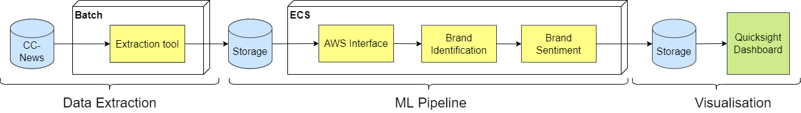
ML Pipeline
Notes:
The machine learning pipeline is this part in red of our product. It takes as input the output of extraction and passes its post-processed output to visualization.

Slide 15
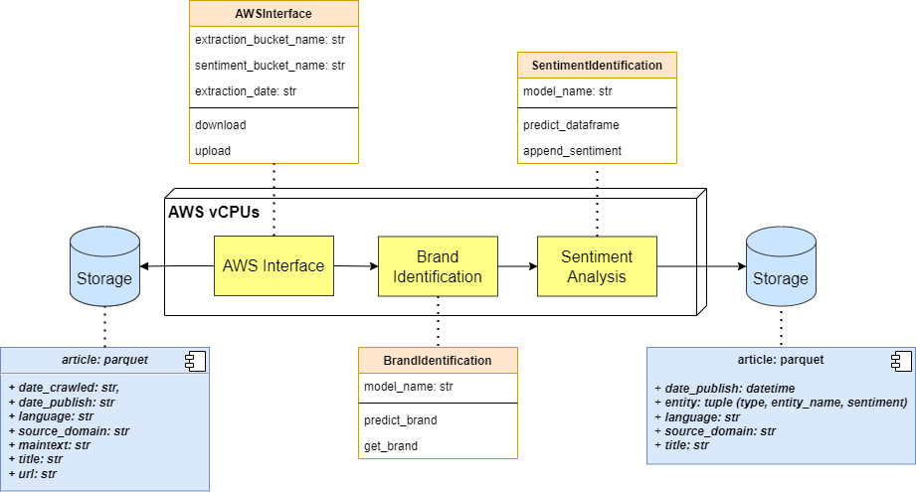
ML Pipeline
Notes:
The ML pipeline consists of three components: AWS Interface, Brand Identification, and Sentiment Analysis:
The AWS interface acts as a filter that requests from the storage the extracted news articles based on the date. It then returns a data frame containing all the news headlines and metadata about them such as source domain and extraction date. This output data frame is now ready to be processed by the rest of the pipeline.

Slide 16
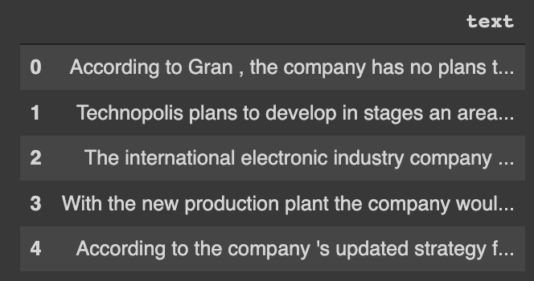
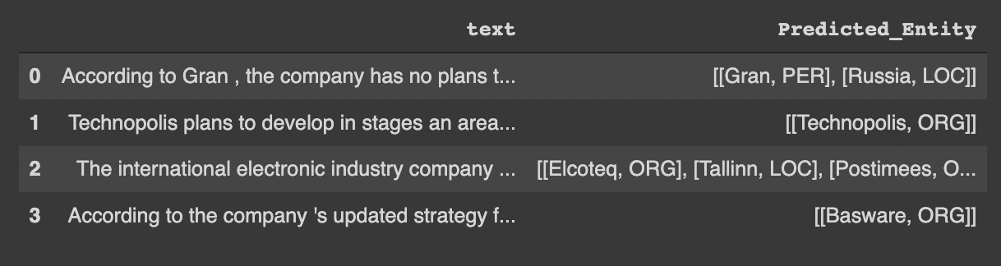
Brand Identification
Input dataframe
News headlines
Output dataframe
“According to Gran, the company has no plans to move all productions to Russia.”
Name Entity Recognition (NER)
Notes:
The Brand Identification class takes the output of AWS interface, specifically the news headlines and performs an NLP task called Name Entity Recognition - NER, which essentially just predicts all the entities contained in each of the headline. For example, this headline says “According to Gran, the company has no plan to move all productions to Russia.” The NER model has successfully predicted “Gran” as a person & “Russia” as a location. It also returns all the detected ORGs, including brands and company names, such as "Technopolis" here, and these entities are at the centre of interest to our project.

Slide 17
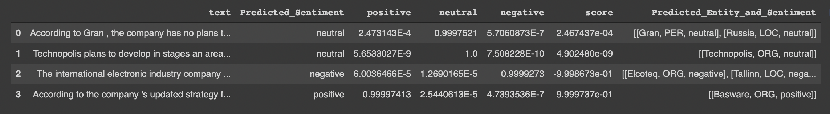
Sentiment Analysis
Input dataframe
Output dataframe
Notes:
The SentimentAnalysis takes as input the output of Brand Identification and for each headline, it predicts the sentiment as one of negative, neutral or positive as well as the confidence score for each class.

Slide 18




Spark NLP by John Snow Labs
Notes:
The BrandIdentification and SentimentAnalysis classes have been defined using the Spark NLP library developed by John Snow Labs, which is an NLP for healthcare company. Spark NLP is the only NLP library built natively on Spark and it enabled us to use state-of-the-art NLP models that have been fine-tuned for specific applications.

Slide 19
NLP Transformer & BERT
Transformer
Self-attention mechanism
BERT
Pre-trained Transformer-based model
Predicts contextual embeddings of words
Fine-tune BERT
Add an additional layer to the network
Fine-tune for NER and Sentiment Analysis – classification problems
Notes:
We delve into some details of the NLP models here. Our NER and sentiment models are based on a type of deep learning models called NLP transformer, which uses the self-attention mechanism to understand sentences by relating words at different positions. Specifically, we used the BERT models, which are gigantic transformer-based models developed by Google that are pretrained on billions of words. BERT solves a prediction problem, such as predicting missing words in a sentence, in order to learn contextual embeddings of words. With the word features being learned, one can then add an additional classification layer to BERT to fine-tune it for tasks such as NER and sentiment analysis.

Slide 20
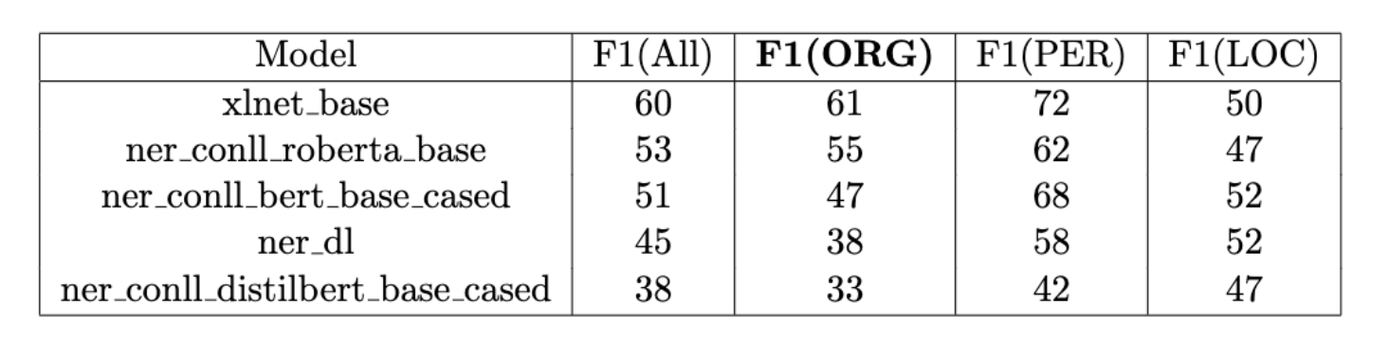
Model Selection & Evalution - NER
Model Selection (on validation set):
Performance on test set: 60% F1 for all entities, 51% F1 for ORGs
77% for all entities and 67% F1 for ORGs if consider partial matching – e.g. “Google Art” (true entity) and “Google” (identified entity)
Notes:
Now we talk about model selection and evaluation. We've tried five pre-trained NER models offered by SparkNLP and compared their performance on a labelled set of 100 headlines. The model XLNet_base was eventually chosen, as it gave the best F1 scores for all entity types and has a relatively fast processing speed. We then evaluated the model on a separate test set. which gives us 60% F1 for all entities and 51% for ORGs. This is where we only considered exact matches of true and predicted entities. If we also include partially matched pairs, such as "Google Art" and "Google", the F1 scores rise to 77% for all entities and 67% for ORGs.

Slide 21
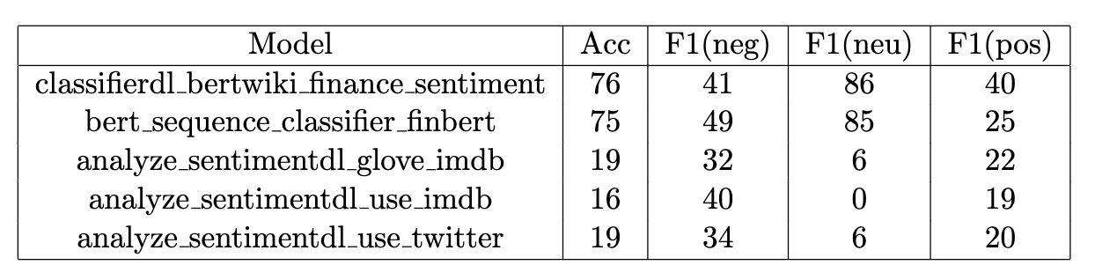
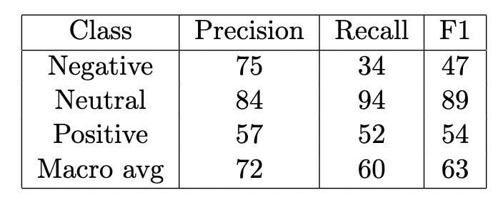
Model Selection & Evalution - Sentiment Analysis
Different models on our own validation dataset
Chosen model on our own test dataset with overall accuracy 82%
Notes:
To select the best model to use, we have compared several pre-trained models from Spark NLP. The metrics of these models on 500 manually labelled headlines are shown in this table. We selected the pre-trained model classifier_dl_bertwiki_finance_sentiment both because it gave the best accuracy and because it was faster than the second-best model. We then manually labelled an additional 500 of our extracted headlines for testing, the results on this dataset are shown in the second table. We achieved an overall accuracy of 82% and good precision metrics. We get relatively low recall rates because our extracted articles talk about a wide range of domains such as politics and crimes and not exclusively finance, and our pretrained model was fine-tuned on financial news. Therefore, to improve the performance of our model, we have also trained a model from scratch on our manually labelled data. We obtained promising results but did not beat the pre-trained model. However, we are confident that labelling more points could lead to better performance and should be considered as future work.

Slide 22
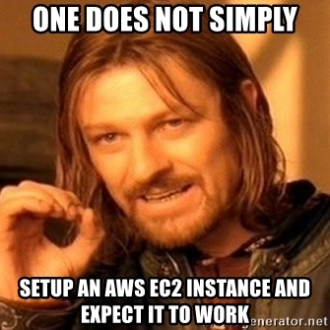
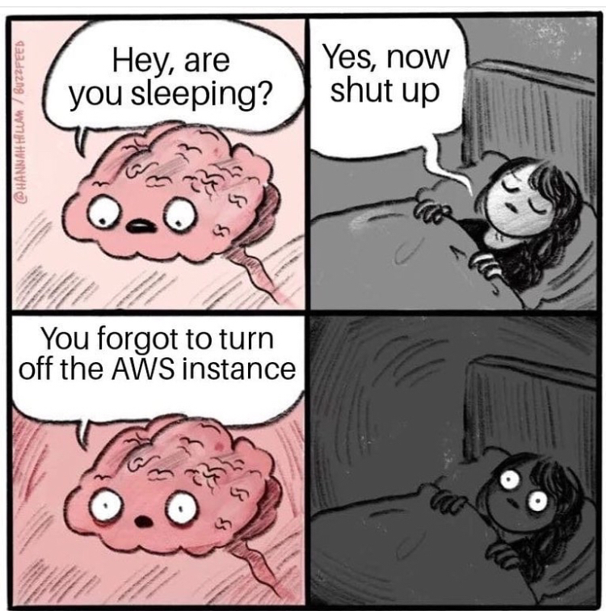
5. Cloud Deployment

Slide 23




Quick AWS Introduction
But first… what is AWS?
Simple Storage Service (S3) File storage.
Batch Run short-lived applications on Docker as jobs.
Quicksight Visualise results from database.
Step Functions Create a low-code pipeline to call multiple AWS services.
Notes:
But briefly, what is AWS?
AWS or ‘Amazon Web Services’ is online platform that allows software engineers to deploy applications on the cloud anywhere in the world. AWS has over 200 different services, specialised for different applications, whether that be Machine Learning, app development, Quantum Computing or Business Intelligence.
AWS is probably the go-to platform for cloud deployment, owning the largest share of cloud services in the world: so much so that other cloud services are built on-top of AWS, such as Heroku.
To understand how we used AWS for our product, there are four main services to know about:
- The first is S3, which is simply, a file storage system. This is what Common Crawl uses to store their petabytes of data and is very cheap for us to use. All files are stored in buckets, which we use to download and upload our articles and sentiment data to.
- The second is AWS Batch, which is a platform for running our article extraction and sentiment analysis applications on. The advantage of Batch is that we can choose how many resources (such as memory and CPUs) to provide our applications with; plus, we only need to pay for how long the applications run for on a daily basis, making them very cost effective.
- The third is Quicksight, which is a low-code platform for visualising results in a database. We connect this up to our S3 buckets to visualise our sentiment analysis for any company.
- And finally, Step Functions, which allows us to tie all of the previous services together to create a pipeline that extracts, analyses and visualises article sentiment on a daily basis.

Slide 24






DevOps
AWS Cloud
GitHub
Batch Extractor Repository
Git push
Third-party Git repository
GitHub Action
GitHub Action
Git users
Image
Amazon Elastic Container Registry (Amazon ECR)
Sentiment Analysis Repository

Slide 25






AWS Pipeline
Version 3
AWS Step Functions workflow
Event (time-based)
Event (event-based)
Event (event-based)
AWS Glue
Crawler
Data Catalog
Amazon S3
AWS Batch
Amazon S3
AWS Batch
Amazon S3
Amazon Athena
Amazon QuickSight
Data Extraction
NLP Pipeline
Visualisation

Slide 26
6. Visualisation

Slide 27
Conclusion
Can we extract news article content from a web-page?
Can we identify articles mentioning a given brand?
Can we detect sentiment in each article?
Can we do all of these at scale?

Slide 28
Thank you for listening!

